Slide 1

Understanding Money Mules: A Critical Threat
A money mule transfers illegally obtained money for others. They are often unaware of the criminal source of funds. Mules receive, move, and withdraw funds, sometimes using wire transfers, cash, or cryptocurrency.
Mansoor Bukhari

Slide 2
Why Do Scammers Use Money Mules?
Obscuring Origin
Anonymity & Bypass
Scammers use mules to hide the illegal origins of funds. This adds layers, making tracking difficult.
Mules help scammers remain anonymous. They also bypass traditional banking system controls.

Slide 3

Fake Job Scams
"Mystery Shopper"
"Payment Processor"
Offers to evaluate store services. These often require handling payments.
Roles handling client payments. Ads appear on job boards or via unsolicited emails.
Account Requirement
These fake jobs demand opening bank accounts for "work," drawing in victims.

Slide 4




Romance Scams
Emotional Manipulation
Financial Requests
Reasons vary: medical bills, travel, or business ventures. Victims send or receive funds unknowingly.
Scammers build online relationships. They then request financial "help" for emergencies.
Significant Losses
In 2023, the average romance scam loss was $14,500. This data comes from the FBI.

Slide 5




Account Rental Scams
Offer to Rent
Scammers request use of bank accounts for a fee. They offer $500-$5000 monthly.
False Pretenses
Reasons include "business expansion" or "tax issues."
Unknowing Aid
Victims grant access, unknowingly helping illegal transfers.

Slide 6



Cryptocurrency Traps
Untraceable
1
Funds are hard to trace and recover after conversion.
Investment Lure
2
Scammers push "investment opportunities" or "secure transfers."
Crypto Conversion
3
Victims convert funds to cryptocurrency, then transfer it to scammers.

Slide 7




The Digital Trail is Broken
Distance Created
Mules create distance between the crime and the criminal. This complicates investigations.
International Challenges
Law enforcement struggles to track funds. International transactions add complexity.
Jurisdictional Issues
Legal jurisdiction problems arise. This further hinders prosecution.

Slide 8

Dangers of Being a Money Mule
Criminal charges include money laundering and fraud.
Penalties are jail time and hefty fines.
Credit scores are damaged, affecting future employment.
Bank accounts can be closed, making new accounts difficult to open.

Slide 9

How to Avoid Becoming a Money Mule
Be Skeptical
Be wary of unsolicited job offers. They are often too good to be true.
Protect Details
Never share bank account details with strangers. This is crucial for security.
Question Requests
Question requests for unusual financial transactions. Always seek clarification.
Research Thoroughly
Research companies before accepting employment. Verify their legitimacy.

Slide 10
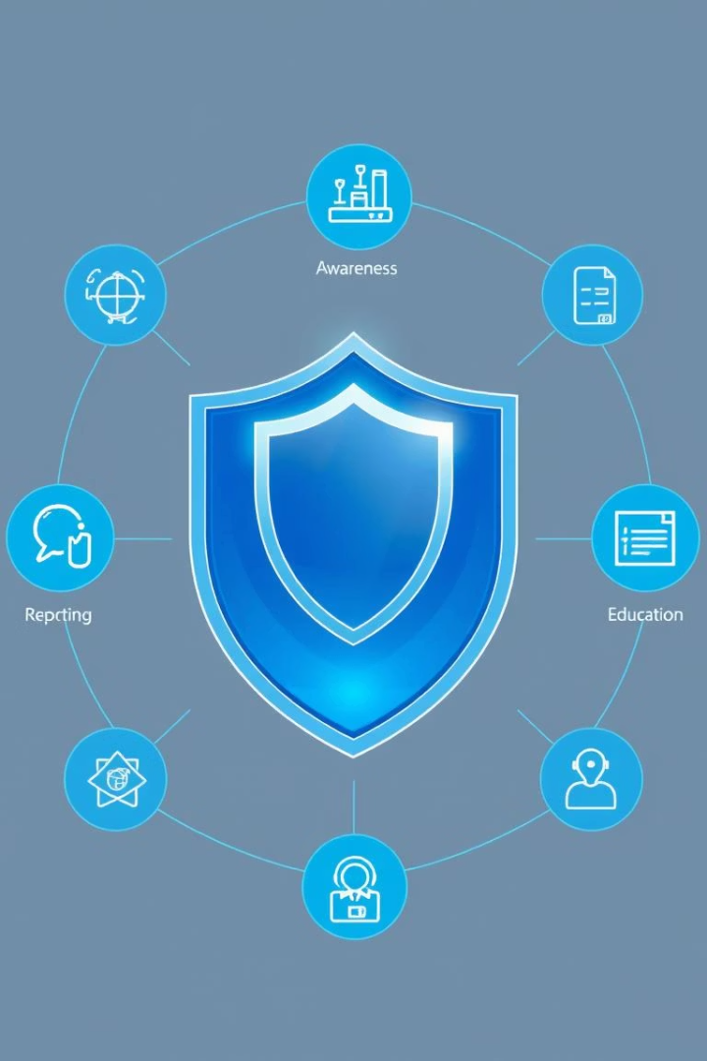




Protect Yourself from Money Mule Scams
Report Suspicious Activity
Verify Legitimacy
Educate Loved Ones
Always verify financial requests. Confirm their authenticity before acting.
Inform friends and family about these scams. Awareness is key.
Report to the FTC and FBI. Early reporting helps prevent further crime.
Stay Informed
Stay updated on the latest fraud tactics. Knowledge protects you.

